Slide 1
Relations and Functions

Slide 2
Review
A relation between two variables x and y is a set of ordered pairs
An ordered pair consist of a x and y-coordinate
A relation may be viewed as ordered pairs, mapping design, table, equation, or written in sentences
x-values are inputs, domain, independent variable
y-values are outputs, range, dependent variable

Slide 3
Example 1
What is the domain?
{0, 1, 2, 3, 4, 5}
What is the range?
{-5, -4, -3, -2, -1, 0}

Slide 4
Example 2
4
–5
0
9
–1
Input
–2
7
Output
What is the domain?
{4, -5, 0, 9, -1}
What is the range?
{-2, 7}

Slide 5
Is a relation a function?
What is a function?
According to the textbook, “a function is…a relation in which every input is paired with exactly one output”
Notes:
5

Slide 6
Is a relation a function?
Focus on the x-coordinates, when given a relation
If the set of ordered pairs have different x-coordinates,
it IS A function
If the set of ordered pairs have same x-coordinates,
it is NOT a function
Y-coordinates have no bearing in determining functions

Slide 7
Example 3
:00
Is this a function?
Hint: Look only at the x-coordinates
YES

Slide 8
Example 4
:40
Is this a function?
Hint: Look only at the x-coordinates
NO

Slide 9
Example 5
:40
Which mapping represents a function?
Choice One Choice Two
–1
2
3
2
–1
3
2
3
–2
0
3
1
0
Choice 1

Slide 10
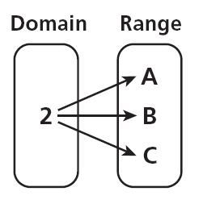
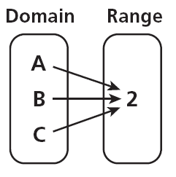
Example 6
Which mapping represents a function?
A. B.
B

Slide 11
Example 7
Which situation represents a function?
a. The items in a store to their prices on a certain date
b. Types of fruits to their colors
There is only one price for each different item on a certain date. The relation from items to price makes it a function.
A fruit, such as an apple, from the domain would be associated with more than one color, such as red and green. The relation from types of fruits to their colors is not a function.

Slide 12
Vertical Line Test
Vertical Line Test: a relation is a function if a vertical line drawn through its graph, passes through only one point. AKA: “The Pencil Test” Take a pencil and move it from left to right (–x to x); if it crosses more than one point, it is not a function

Slide 13
Vertical Line Test
Would this graph be a function?
YES

Slide 14
Vertical Line Test
Would this graph be a function?
NO

Slide 15
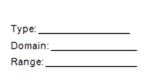
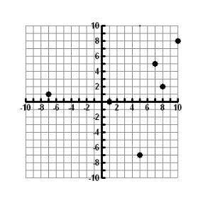
Is the following function discrete or continuous? What is the Domain? What is the Range?
Discrete

Slide 16
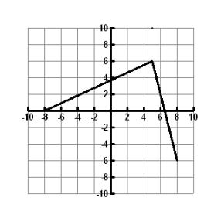
Is the following function discrete or continuous? What is the Domain? What is the Range?
continuous

Slide 17
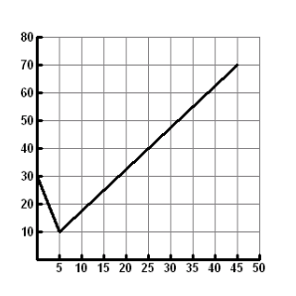
Is the following function discrete or continuous? What is the Domain? What is the Range?
continuous

Slide 18
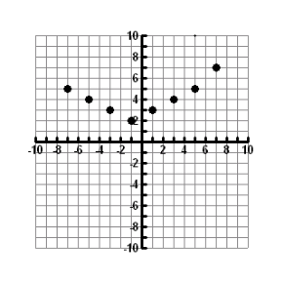
Is the following function discrete or continuous? What is the Domain? What is the Range?
discrete

Slide 19
Function Notation
f(x) means function of x and is read “f of x.”
f(x) = 2x + 1 is written in function notation.
The notation f(1) means to replace x with 1 resulting in the function value.
f(1) = 2x + 1
f(1) = 2(1) + 1
f(1) = 3

Slide 20
Function Notation
Given g(x) = x² – 3, find g(-2) .
g(-2) = x² – 3
g(-2) = (-2)² – 3
g(-2) = 1

Slide 21
Function Notation
Given f(x) = , the following.
a. f(3)
b. 3f(x)
c. f(3x)
f(3) = 2x² – 3x
f(3) = 2(3)² – 3(3)
f(3) = 2(9) - 9
f(3) = 9
3f(x) = 3(2x² – 3x)
3f(x) = 6x² – 9x
f(3x) = 2x² – 3x
f(3x) = 2(3x)² – 3(3x)
f(3x) = 2(9x²) – 3(3x)
f(3x) = 18x² – 9x

